Slide 1
Developer Setup Getting and Working With React.js
Jon Galloway | Technical Evangelist
Christopher Harrison | Content Developer

Slide 2
CDN and Script Reference

Slide 3
CDN References
Development
<script src="https://fb.me/react-0.14.0.js"></script>
<script src="https://fb.me/react-dom-0.14.0.js"></script>
Production
<script src="https://fb.me/react-0.14.0.min.js"></script>
<script src="https://fb.me/react-dom-0.14.0.min.js"></script>

Slide 4
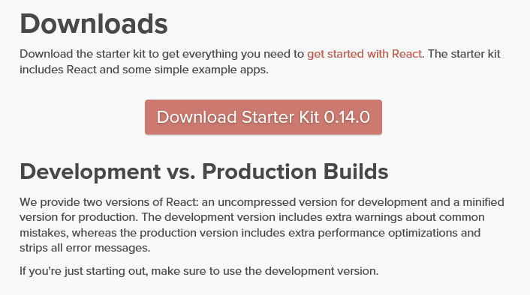
Scripts
http://facebook.github.io/react/downloads.html

Slide 5
Using React via CDN
Notes:
http://plnkr.co/edit/P85PYJwnrAtdlum4AW9Q?p=preview
var Example = React.createClass({ render: function() { return ( <div>Hello Monkey</div> ) }}); React.render(<Example />, document.getElementById('content'))

Slide 6
Bower

Slide 7
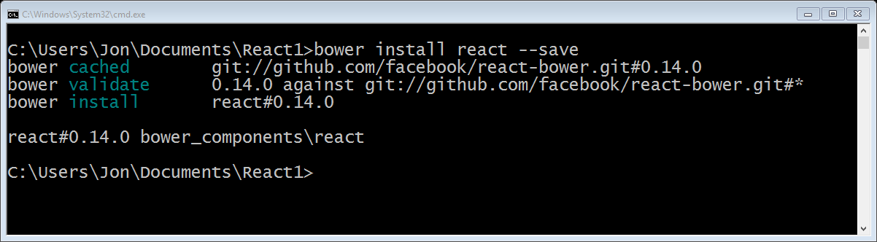
Bower

Slide 8
Bower

Slide 9
Yeoman Generator

Slide 10
Yeoman
Scaffolder
Used to create an application skeleton
Usually kind of opinionated, pick your favorite

Slide 11
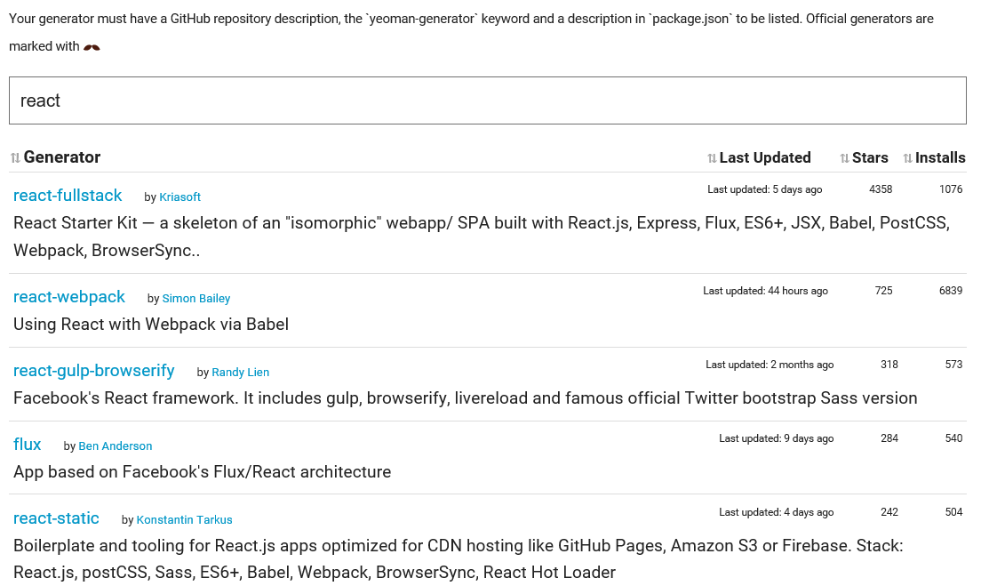
Installing Yeoman Generators

Slide 12
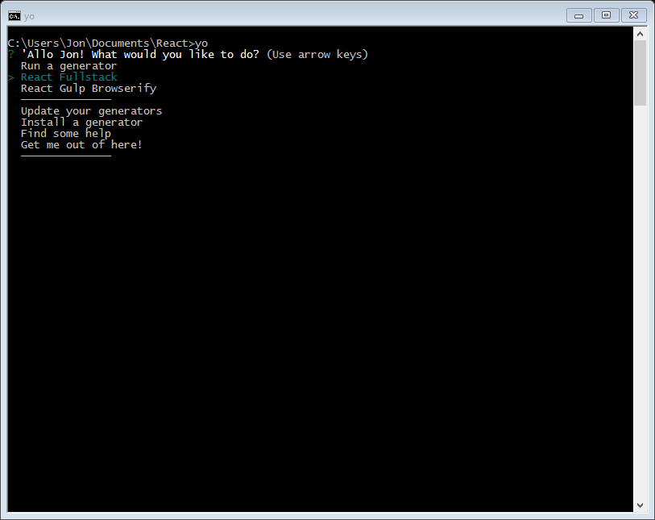

Slide 13
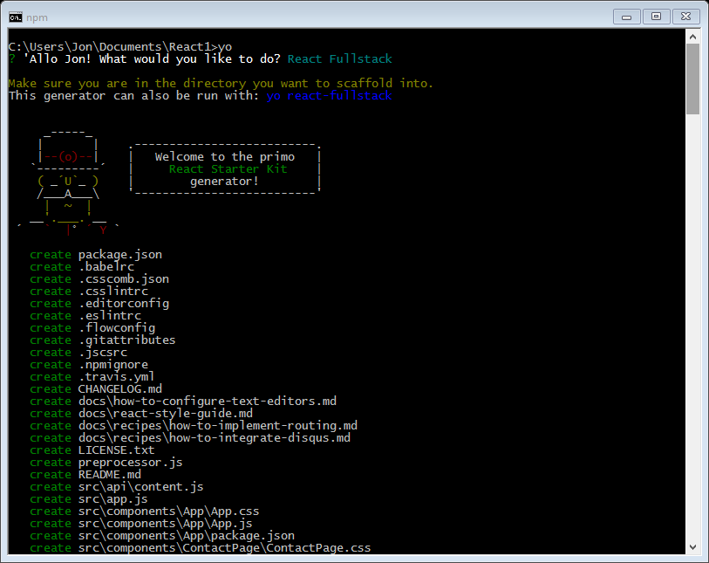

Slide 14
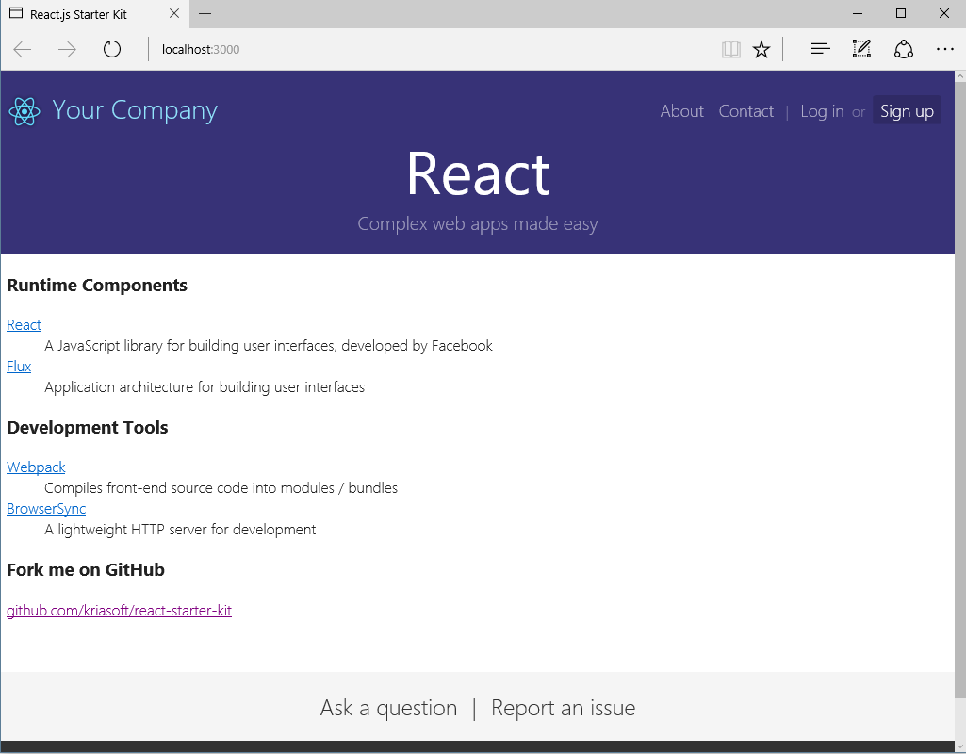

Slide 15
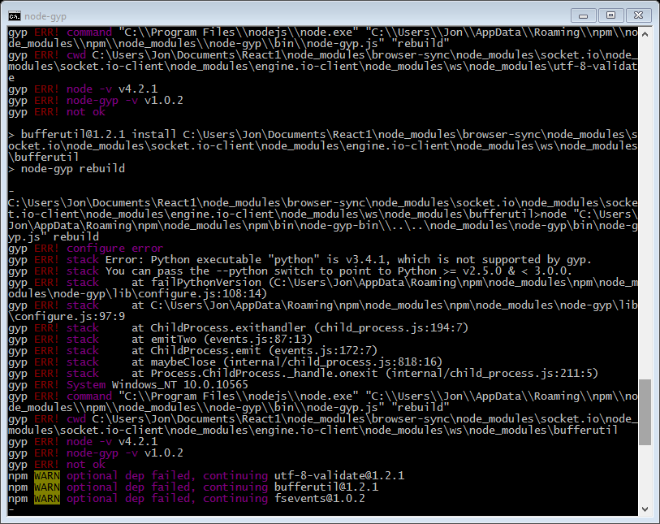

Slide 16
Yeoman

Slide 17
Working with React.js in Visual Studio and ASP.NET

Slide 18
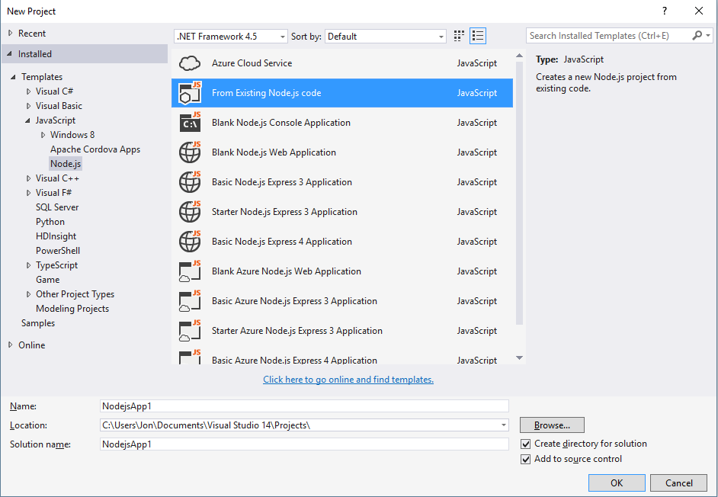
NTVS

Slide 19
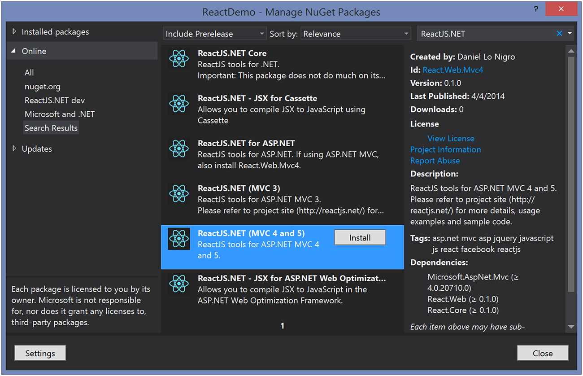
ReactJS.NET

Slide 20
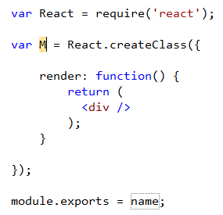


Visual Studio extensions
React
Snippet Pack
Web
Compiler
Web Analyzer

Slide 21
React with Visual Studio

